Slide 1
ABC COMPANY · CHRO BRIEFING · MARCH 2026
Sales Team Talent Rotation Analysis
71
TOTAL
MOVEMENTS
Cross-regional & intra-regional employee
movement across India Sales Clusters
SWCC — S · W · Central · CSD
ZEN — East · North 1 · North 2
HO / KA

Slide 2
AT A GLANCE · KEY MOVEMENT METRICS
Movement Summary — All Clusters
77% of all moves are intra-regional · 23% cross-cluster
71
32
31
8
16
Total Movements
ZEN Movements
SWCC Movements
HO / KA Moves
Cross-Regional
All clusters combined
East · N1 · N2
S · W · C · CSD
Head Office + Key Accts
22.5% of all moves

Slide 3
DRAFT 1A · REGIONAL VOLUME OVERVIEW
Internal vs. Cross-Regional Breakdown by Cluster
How much movement happens within each region vs. inbound from outside

Slide 4
DRAFT 1B · TOTAL MOVEMENT RANKING
Which Cluster Has the Highest Rotation?
Absolute number of moves per cluster — internal + cross-regional combined
ZEN leads · 32 total
SWCC · 31 total
HO/KA · 8 total (stable)

Slide 5
DRAFT 2 · CROSS-REGIONAL TALENT FLOW MAP
Where Are People Moving Across Boundaries?
Arrow thickness = volume · Labels show headcount · Net flow highlights talent migration direction
ZEN
Marketing
KA North
1
Feeder
1
Key Accounts
East · North 1 · North 2
Internal: 27 moves
1
HO
Head Office
4
Net: ZEN → SWCC +2
6
1
SWCC
KA South
2
Key Accounts
South · West · Central · CSD
Internal: 22 moves
ZEN → SWCC (6)
SWCC → ZEN (4)
KA flows (3)
HO outflows (2)
Marketing → HO (1)

Slide 6
DRAFT 3A · SWCC CLUSTER BREAKDOWN
SWCC Sub-Region Movement Analysis
South · West · Central · CSD — internal rotation patterns

Slide 7
DRAFT 3B · ZEN CLUSTER BREAKDOWN
ZEN Sub-Region Movement Analysis
East · North 1 · North 2 · North Region — internal rotation patterns

Slide 8
DRAFT 4 · MOVEMENT MATRIX — HEATMAP
From → To Movement Matrix
Darker colour = higher volume · Diagonal entries = within-cluster rotation
FROM \ TO | → HO | → KA North | → SWCC | → ZEN
Marketing | 1 | — | — | —
HO | — | 1 | 1 | —
KA North | — | 3 | — | 1
KA South | — | — | 2 | —
SWCC | — | — | 22 | 4
ZEN | — | — | 6 | 27
No movement
Low (1–3)
Medium (4–9)
High (10+)

Slide 9
DRAFT 5 · ROTATION MIX & SUB-REGION ACTIVITY DEPTH
Internal vs. External Mix (%)
Sub-Region Activity Ranking
ZEN most self-contained · SWCC highest external inflow
North 2 & West drive highest individual volume

Slide 10
CHRO EXECUTIVE SUMMARY · KEY STRATEGIC INSIGHTS
Sales Team Talent Rotation — ABC Company
01
ZEN is the Most Active Cluster
02
SWCC Has Highest External Inflow
32 total movements — the highest of any cluster. 27 internal moves show a strong internal talent pipeline in East & North.
SWCC absorbed 9 from outside (ZEN: 6, KA South: 2, HO: 1) — net inflow of +5. SWCC is a talent magnet, likely driven by West & South growth.
03
ZEN → SWCC Net Drain: Watch This
04
North 2 & West Are High-Churn Sub-Regions
6 moved ZEN→SWCC vs 4 SWCC→ZEN. Net -2 from ZEN. If this persists, North & East may develop capability gaps over time.
North 2 (11 moves) and West (8 moves) dominate internal rotation. These sub-regions need active succession planning.
05
77% of All Moves Are Intra-Regional
06
HO / KA Shows Minimal Rotation
55 of 71 moves are within the same cluster — a healthy sign of internal career development before cross-functional deployment.
Only 8 total moves. May signal strategic stability at senior levels — or a structural gap restricting upward/lateral mobility.
OVERALL HEALTH: Moderately healthy talent mobility culture (71 moves, balanced mix). KEY RISK: Concentrated churn in North 2 & West — monitor for hidden attrition or performance pressure.

Slide 11
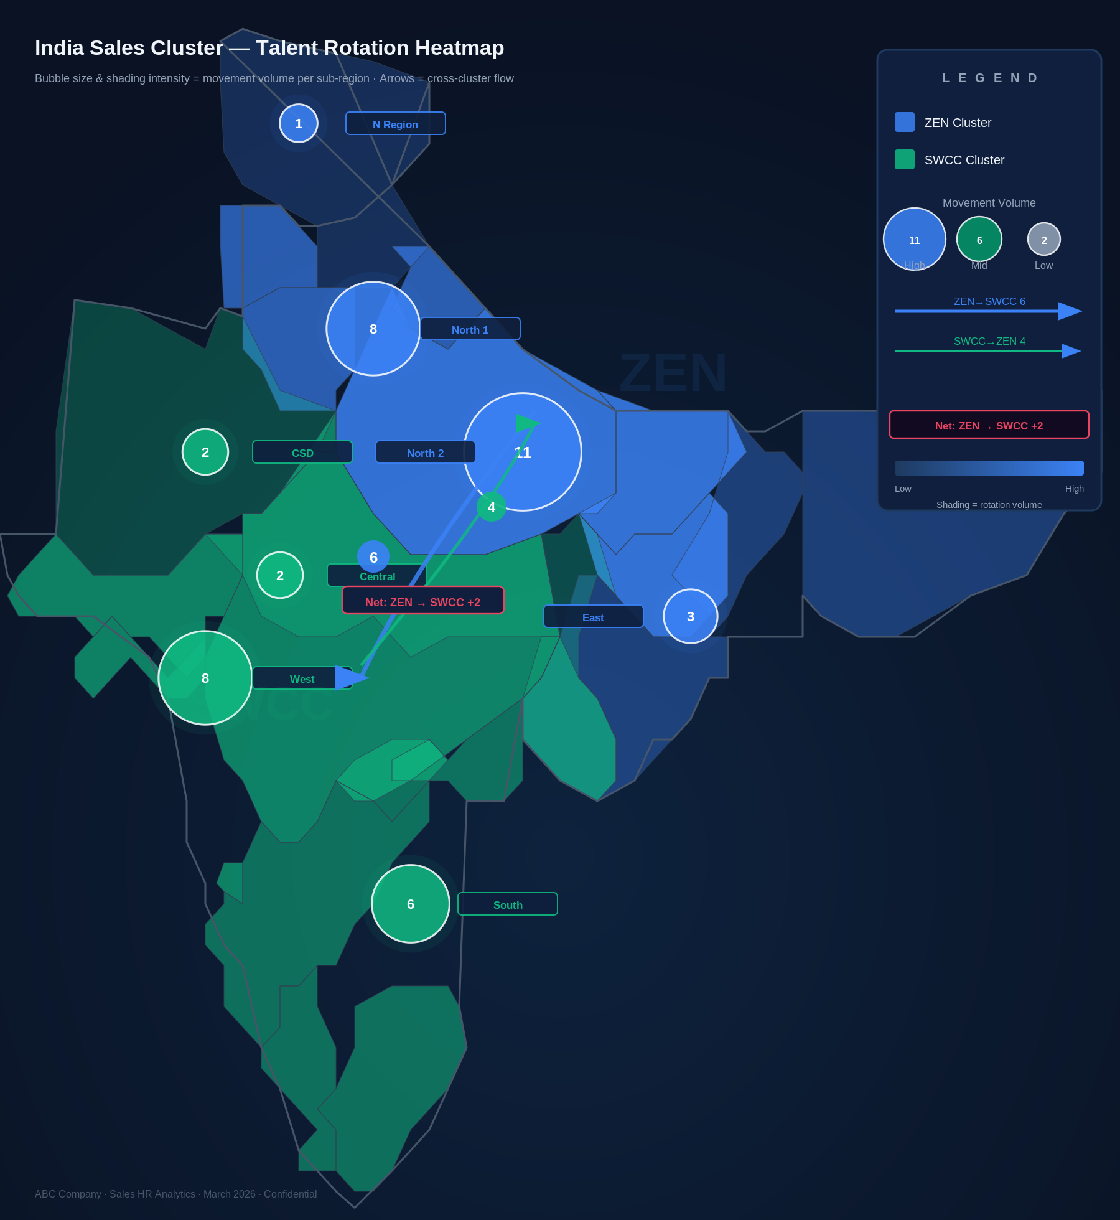
DRAFT 8 · INDIA REGIONAL TALENT ROTATION HEATMAP
Sub-region movement volume across India Sales Clusters — ZEN (Blue) vs SWCC (Green)
KEY DATA
North 2 (ZEN)
11
North 1 (ZEN)
8
West (SWCC)
8
South (SWCC)
6
East (ZEN)
3
Central (SWCC)
2
CSD (SWCC)
2
N Region (ZEN)
1
ABC Company · HR Analytics · March 2026

